Slide 1

Lab 5: REST API and webscraping

Slide 2
Objectives
Understand RES APIs
Using BeautifulSoup module for webscraping
Lab 5

Slide 3
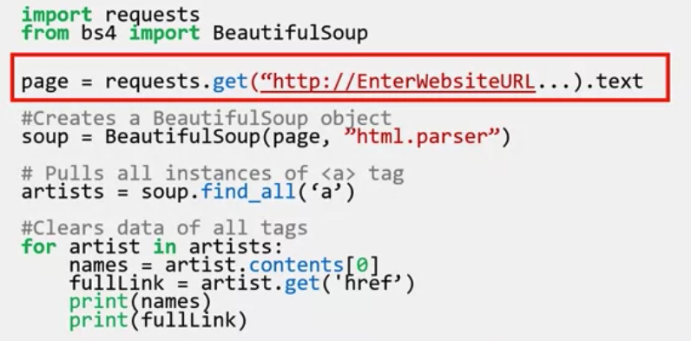
Requires
This is an example code to scrapping data from web page
Lab 5

Slide 4
Requires
1. Implement that code by change the URL
2. You are request to find the highest price of gold in Vietnam during 6 months ago
  Giavang.net. ...
  Giavangvn.org. ...
  Trang 24h. ...
  Goldprice.org. ...
  Webgia.com. ...
  Tygia.com.
Lab 5

Slide 5
Q & A
Lab 5

